Slide 1


Dark sides of technology
By
Kolluri mounav and
Motamarri jaya naga Venkata sai

Slide 2

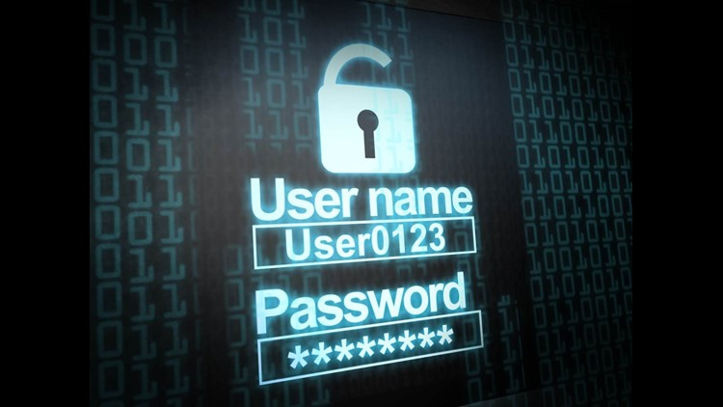

Types of webs
1.Surface web
2.Deep web
3. Dark web
.

Slide 3


Surface web
The Surface Web (also called the Visible Web, Indexed Web, Indexable Web or Lightnet) is the portion of the World Wide Web that is readily available to the general public and searchable with standard web search engines.
It is the opposite of the deep web, the part of the web not indexed by a web search engine.
The Surface Web only consists of 10 percent of the information that is on the internet.
The Surface Web is made with a collection of public Web pages on a server accessible by any search engine.

Slide 4
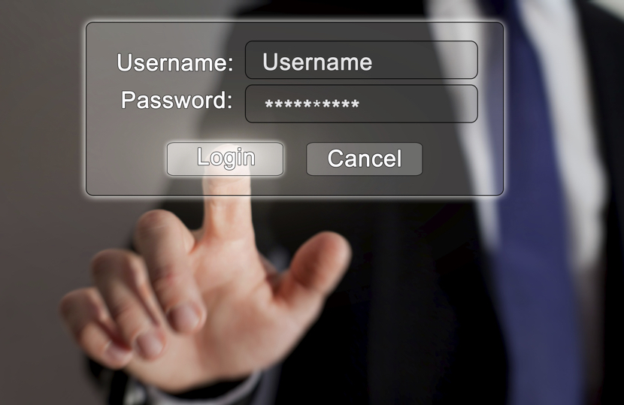

Deep web
The deep web, invisible web,or hidden web are parts of the World Wide Web whose contents are not indexed by standard web search-engines. The opposite term to the deep web is the "surface web", which is accessible to anyone/everyone using the Internet. Computer-scientist Michael K.
Bergman is credited with coining the term deep web in 2001 as a search-indexing term. The content of the deep web is hidden behind HTTP forms and includes many very common uses such as web mail, online banking, private or otherwise restricted access social-media pages and profiles.
Some web forums that require registration for viewing content, and services that users must pay for, and which are protected by paywalls, such as video on demand and some online magazines and newspapers.
The content of the deep web can be located and accessed by a direct URL or IP address, but may require a password or other security access to get past public-website pages.

Slide 5


Dark web
The dark web is the World Wide Web content that exists on darknets: overlay networks that use the Internet but require specific software, configurations, or authorization to access.
Through the dark web, private computer networks can communicate and conduct business anonymously without divulging identifying information, such as a user's location.
The dark web forms a small part of the deep web, the part of the Web not indexed by web search engines, although sometimes the term deep web is mistakenly used to refer specifically to the dark web. The darknets which constitute the dark web include small, friend-to-friend peer-to-peer networks, as well as large, popular networks such as Tor, Freenet, I2P, and Riffle operated by public organizations and individuals. Users of the dark web refer to the regular web as Clearnet due to its unencrypted nature.
The Tor dark web or onionlanduses the traffic anonymization technique of onion routing under the network's top-level domain suffix .onion.

Slide 6
About Dark Web
The World Wide Web is much larger than the information and sites that are accessed by regular browsers and indexed by traditional search engines. According to a study by Bright Planet, it is 500 times larger than the surface web or visible Internet, which is used daily by billions of people. However, the largest amounts of data on the WWW are topic-specific and not necessarily relevant when the size of the Dark Web is investigated.
This includes specialist databases, library catalogs, links, secret data from organizations such as NASA or the database of the National Climatic Data Center. Such information is not accessible to search engines such as Google, but cannot be considered a real Dark Web. The terms Visible Web, Deep Web, and Dark Web are often confused and misused in this context.

Slide 7
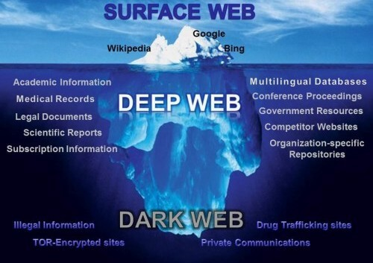
Usage of these webs in our Daily Life
The Surface Web only consists of 10 percent of the information that is on the internet. The Surface Web is made with a collection of public Web pages on a server accessible by any search engine.
Estimates place the size of the deep web at between 96% and 99% of the internet. Only a tiny portion of the internet is accessible through a standard web browser—generally known as the “clear web”.
The Dark Web comprises only 3% of the traffic in the Tor network. A February 2016 study from researchers at King's College London gives the following breakdown of content by an alternative category set, highlighting the illicit use of . onion services

Slide 8
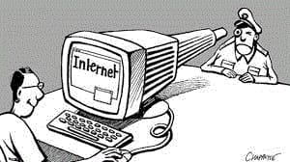
Lack Of Privacy
The use of viruses and hacking helps to find any information they wish to obtain.
Social networks themselves are evolving and, as such, some of the settings that could offer the necessary security and privacy are still emerging.
The ease of use aspect of the major social networks, such as Facebook, Twitter and LinkedIn, undermines their privacy and security features

Slide 9

How Hackers Violate Your Privacy
More of our lives are online as technology becomes more advanced. As a result, it's crucial to know how to protect yourself from hackers and online predators.
But you can't do that without understanding what you're protecting yourself from.
Many hackers are just tech-savvy thieves with money as their motive, but that's not always the case. Hackers have highly diverse motives. There are hackers who are trying to pull publicity stunts or fight for a worthy (or not-so-worthy) cause. There are others out to attack business or personal rivals. Still others want to practice their hacking skills out of a sense of curiosity or just for fun.

Slide 10

Unfortunately, many people often make hackers' jobs easy for them. Hackers can easily plant viruses on computers to automatically steal information, or use phishing to con you into handing over your information willingly.
While ignorance can make you an easy target, learning about hackers, their tools and motives, and how to protect yourself makes you someone they're more likely to avoid. Just like how increasing your home security makes thieves less likely to break into your house, leveling up your computer security skills will turn hackers away as they seek easier targets.

Slide 11

Hacking prevention: tips to reduce your attack surface
These days it seems that every time you open your favorite news source there is another data breach related headline. Victimized companies of all sizes, cities, counties, and even government agencies have all been the subject of the “headline of shame” over the past several months or years.
With all this publicity and the increasing awareness of the general public about how data breaches can impact their personal privacy and financial wellbeing, it is no surprise that there is a lot of interest in preventing hacking.
The trouble is that there is no way to prevent others from attempting to hack into any target they chose. Since there is a practically limitless number of targets to choose from, the attacker need only be lucky or skilled enough to succeed once.
In addition, the risk of successful prosecution of perpetrators remains low. However, while you can’t prevent hacking, you can help to reduce your attack surface to make your organization less likely to be the subject of attacks.

Slide 12
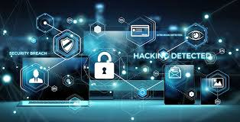
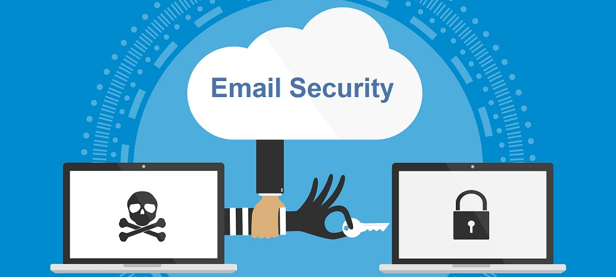
Some tips to prevent Hacking
1.Patch and Update Constantly: Ultimately the most hacker-resistant environment is the one that is best administered. Organizations are short cutting system and network administration activities through budget / staff reductions and lack of training. This practice often forces prioritization and choice about what tasks get done sooner, later or at all. Over time this creates a large, persistent baseline of low to medium risk issues in the environment that can contribute to a wildfire event under the right conditions. Lack of a complete asset inventory – both hardware and software – contributes to this risk as applications and devices become unmanaged. Staying on top of patching, system/application updates, end of support/life platform migrations, user administration and configuration management is tedious, time consuming, and generally underappreciated; but this activity - more than any other single task, will reduce the risk of cyber events in an organization and dramatically reduce the risk of opportunistic attacks.
2. Email Security: Email is the number one entry point for malware into the enterprise. No surprise really. Given all the data that has pointed to this as the root cause of many breach events, it should be the next place where organizations double-down on security. It is very important that organizations take the time to be informed consumers in this regard and understand what threats the email controls are preventing and what the remaining exposures are so that a layered control model can be put in place.

Slide 13
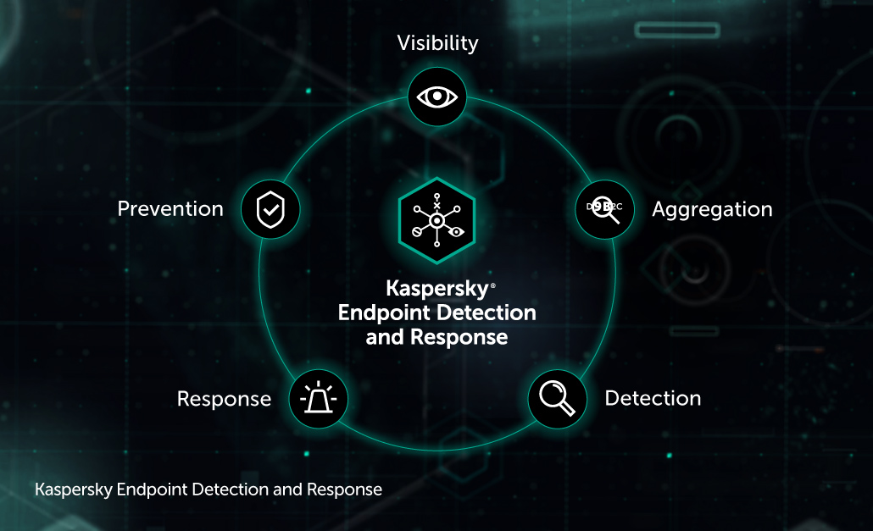
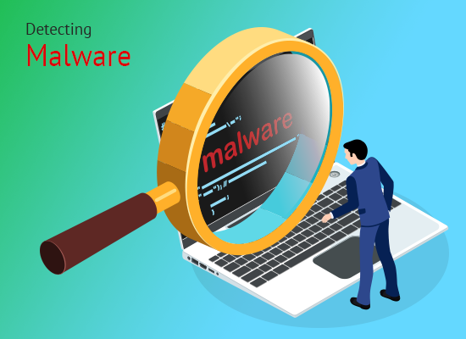
3.Endpoint Detection and Response: Most of that email is destined for a user that will click on attachments and potentially infect themselves with malware of some kind. The second most common malware infection vector is through malicious web content; also, an end-user action. As a result, it makes sense to have a thorough suite of controls on the endpoints and servers in the environment to identify and shutdown viruses, malware, and other potentially unwanted programs. Making sure that all endpoints are under management and kept current will help prevent whack-a-mole malware infections that can persist in environments with inconsistently applied controls.
4.Segmentation and Egress Filtering: Just because a hacker or piece of malware makes its way into your environment, doesn’t mean they should be able to spread adjacent network nodes or waltz back out with your mission critical, regulated data. Limiting the ability to communicate both across and outside the network through a combination of controls such as firewall policies and requiring the use of proxy servers is an often-overlooked opportunity for organizations to increase their security, limit the impact of an incident and help prevent a network incident from becoming a public data breach.

Slide 14

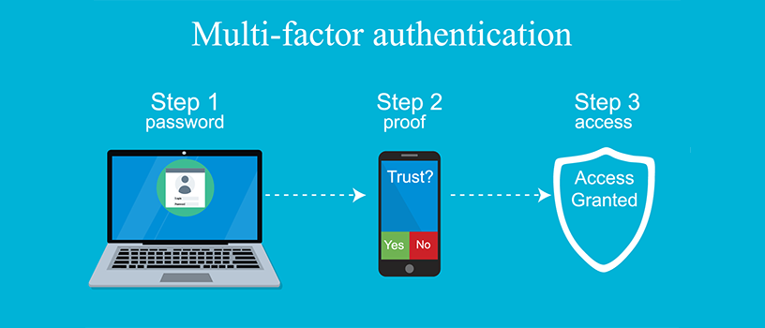
5.Robust Detection Control Infrastructure: History teaches us that prevention-centric strategies will fail and should be paired with detective controls to minimize time to detection and remediation. Make certain you have a well-tuned SIEM/SOAPA/SOAR infrastructure as part of your security architecture and that that is receiving logs that cover the internal network and applications as well as through the perimeter. This includes tuning of endpoint, application, and network device logs to enable an early detection and response capability in the environment.
6.Multi-factor / Multi-step Authentication: The majority of breaches involve the use of cracked, intercepted or otherwise disclosed authentication credentials at some point. Use strong, multi-factor authentication methods by default wherever possible. Combined with the ability to detect and alert on failed login attempts, this practice can provide clues to users that may be the focus of targeted attacks.

Slide 15

Done by
K.MOUNAV
M.J.N.V SAI

